Slide 1
Replicated Contextformer Predictions Initial Results
Dong Zhang CCRS Government of Canada October 30, 2025

Slide 2
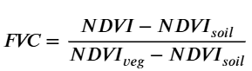
Outline
Purpose?
Assess the accuracy of Contextformer with our own minicubes
What we did
Generated Contextformer NDVI predictions on replicated minicubes
2 sites from May – July and 1 from July – September
Minicubes were replicated using the ‘nasadem’ provider in place of ‘srtm’
Compared predicted NDVI to Sentinel 2 measurements within 5 days
Approximated fCover using the following formula
NDVI_{soil} is taken to be the minimum NDVI value
NDVI_{veg} is taken to be the maximum NDVI value
Main findings
Mostly correct patterns, except for timestep 10 on site 2
Fine and coarse scale blocking for agriculture

Slide 3
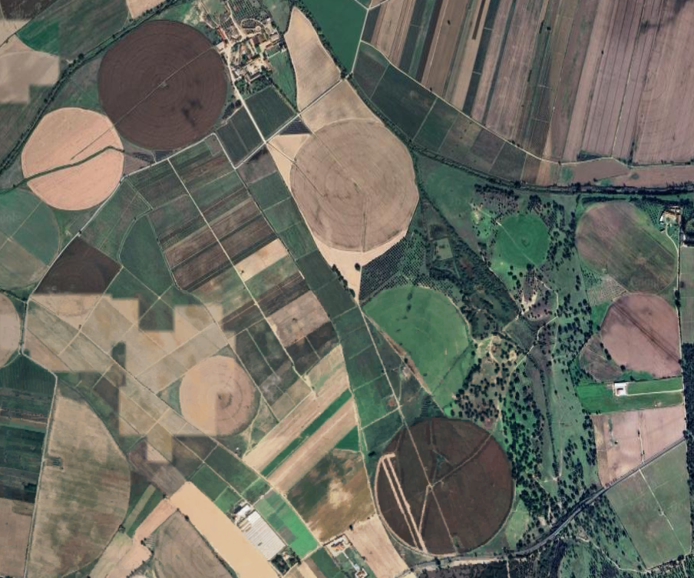
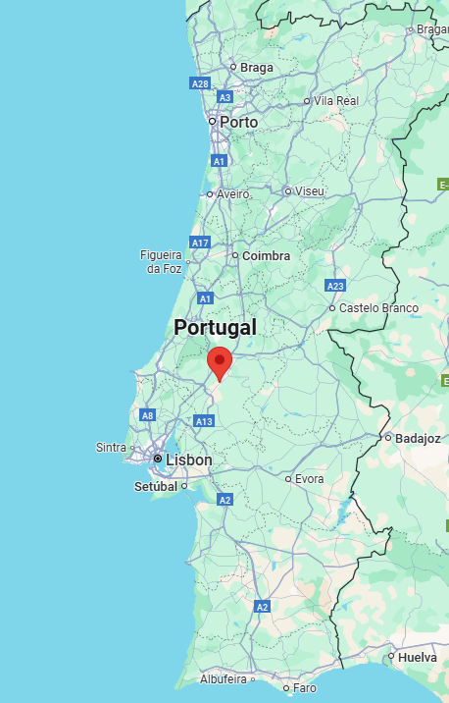
Site 1: Portugal
ood-t JAS2021 minicube_0_29SND_39.29_-8.56

Slide 4
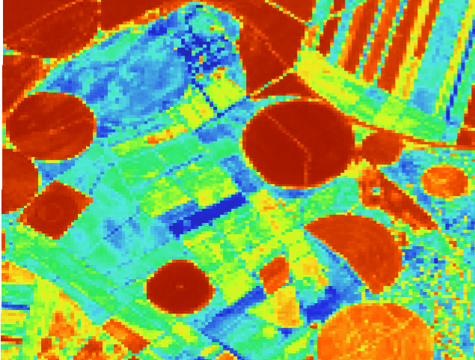
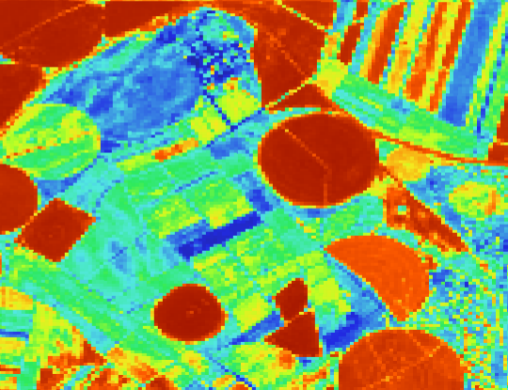
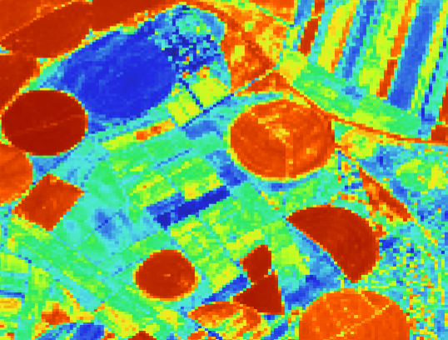
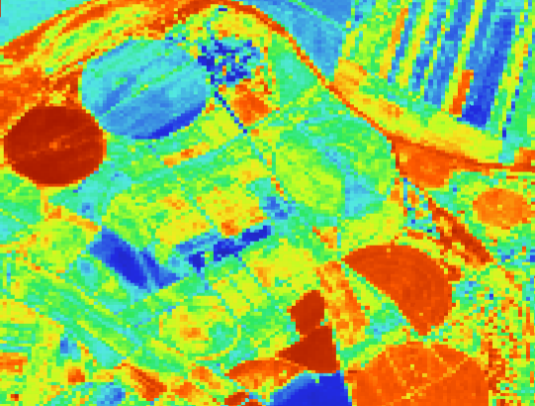
Actual NDVI
Timestep 6 July 28
Timestep 10
August 17
Timestep 15
September 11
Timestep 20
October 6

Slide 5
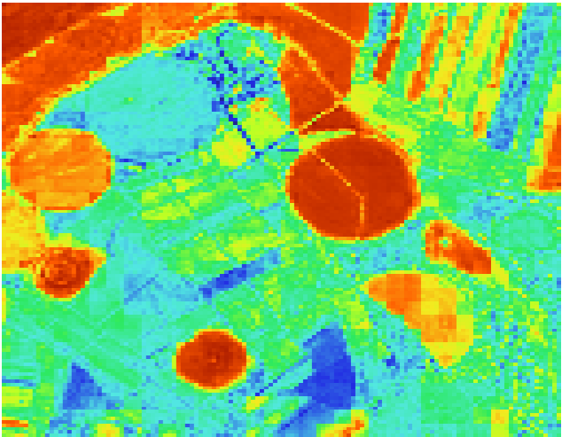
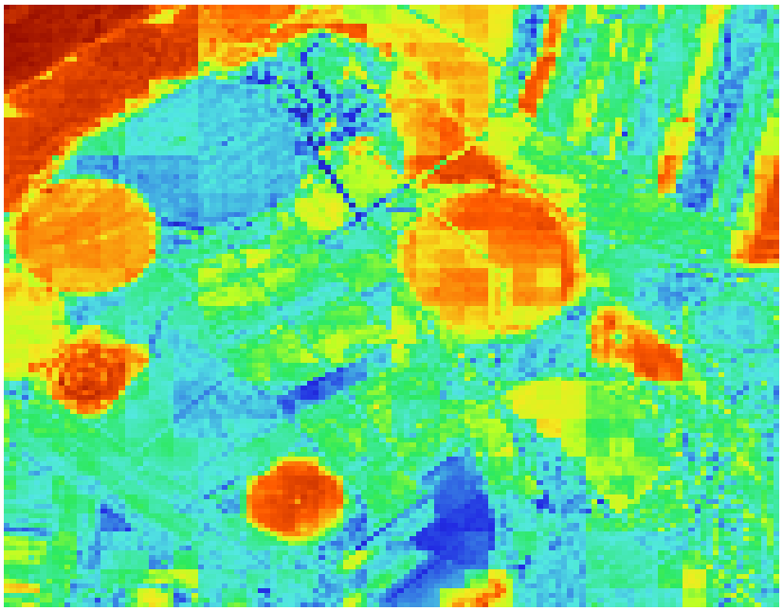
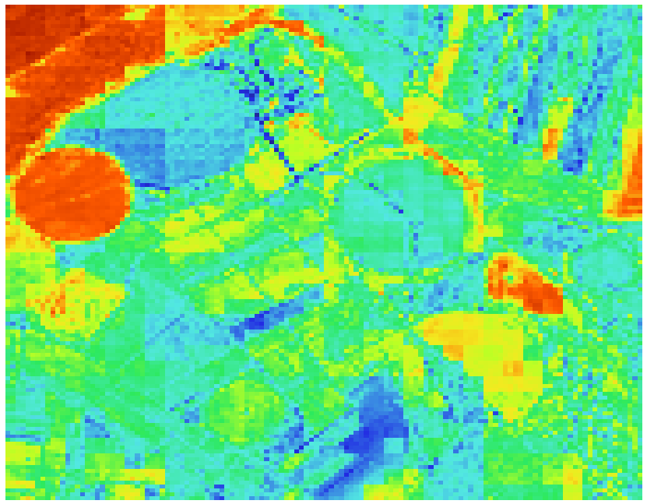
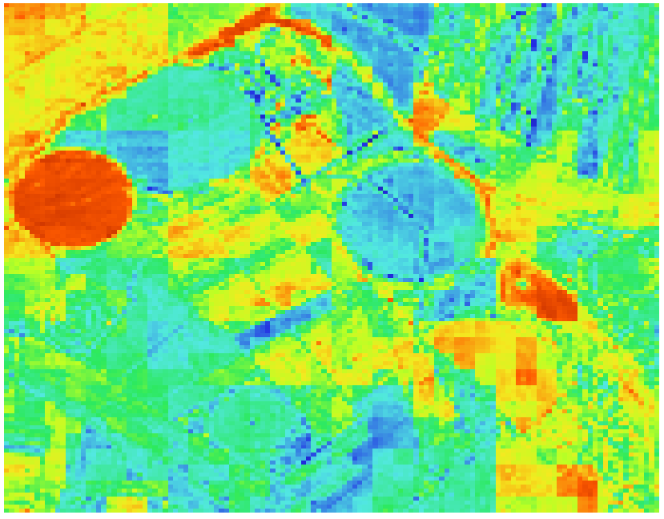
Predicted NDVI
Timestep 6 July 28
Timestep 10
August 17
Timestep 15
September 11
Timestep 20
October 6
Notes:
Time evolution looks reasonable, but there are obvious lines down and across the middle of timestep 20 along with blocking.

Slide 6
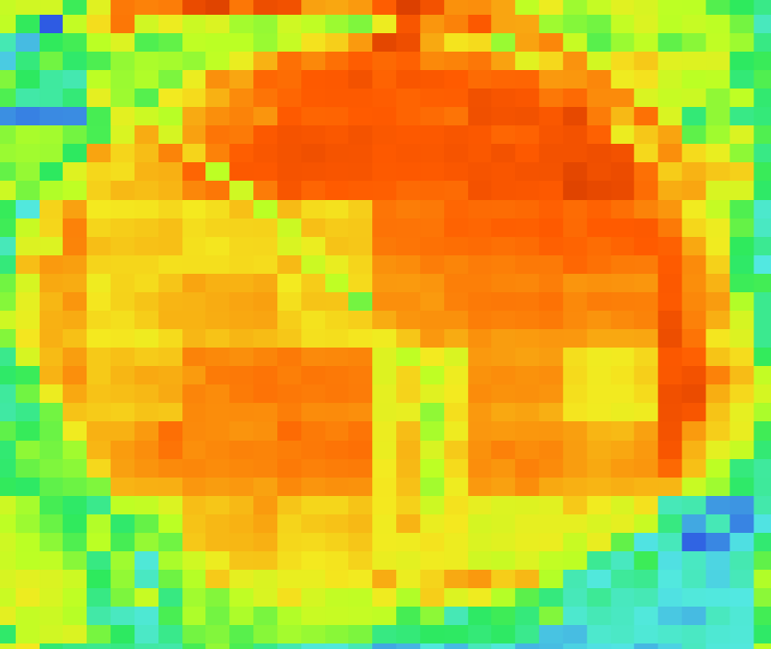
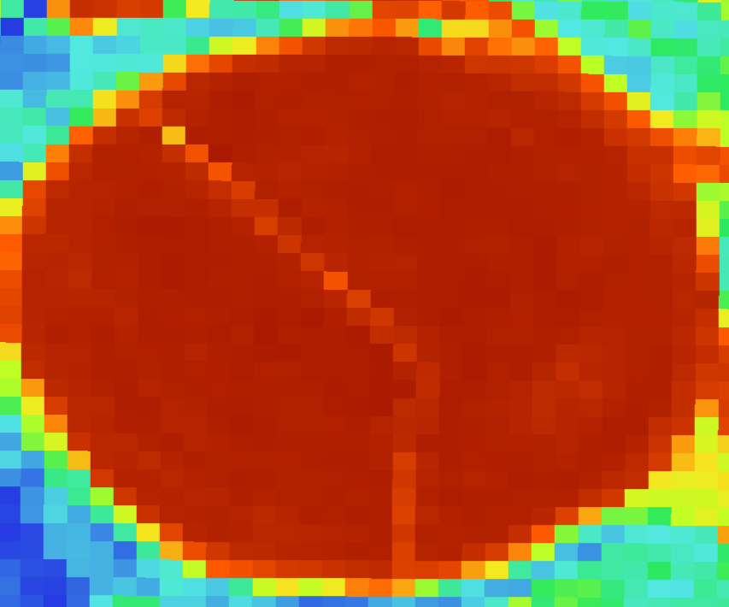
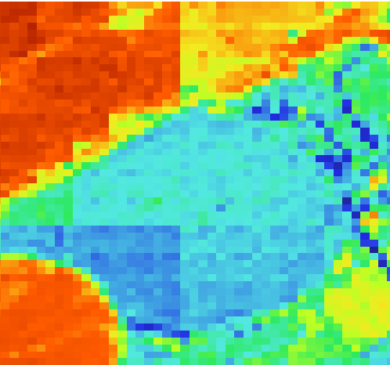
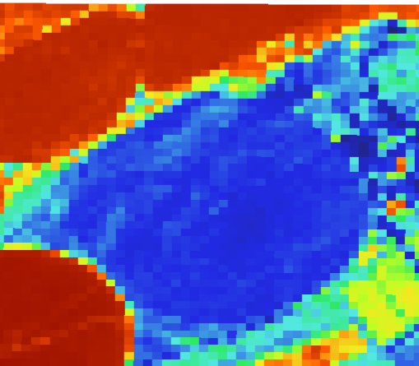
Artifacts
Predicted
Actual
Timestep 10 August 17
Timestep 15
September 11
Notes:
Fine and coarse scale blocking effects need to be understood, though fine scale is less important. What happens when using pvt with larger blocks or different hyper parameters

Slide 7
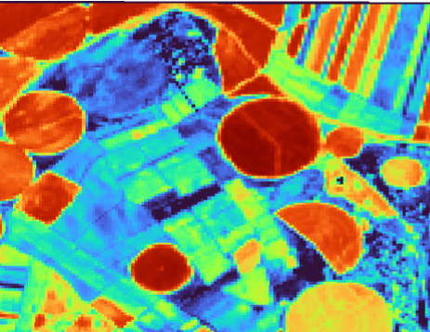
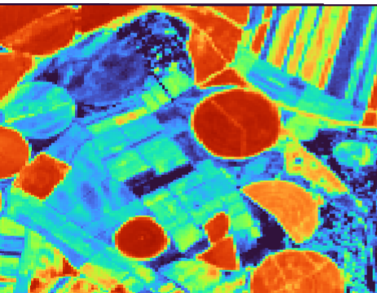
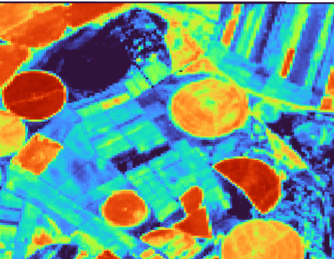
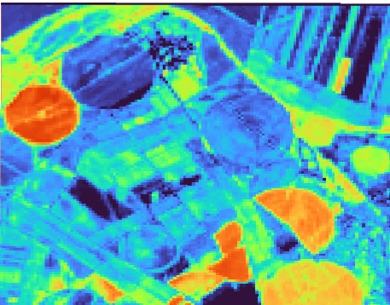
Actual fCover
Timestep 6 July 28
Timestep 10
August 17
Timestep 15
September 11
Timestep 20
October 6

Slide 8
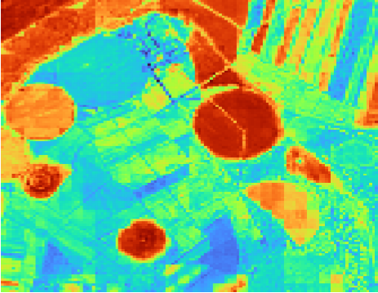
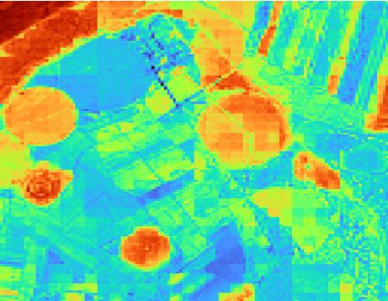
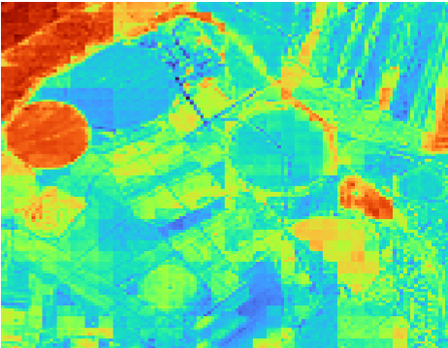
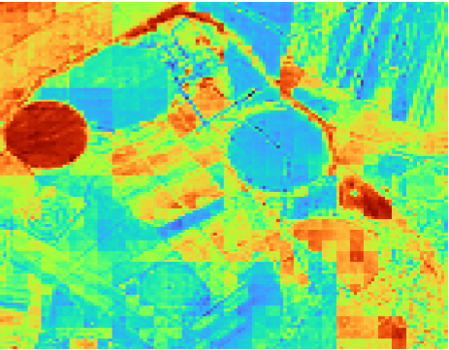
Converted fCover
Timestep 6 July 28
Timestep 10
August 17
Timestep 15
September 11
Timestep 20
October 6
Notes:
Time evolution looks reasonable, but there are obvious lines down and across the middle of timestep 20 along with blocking.

Slide 9
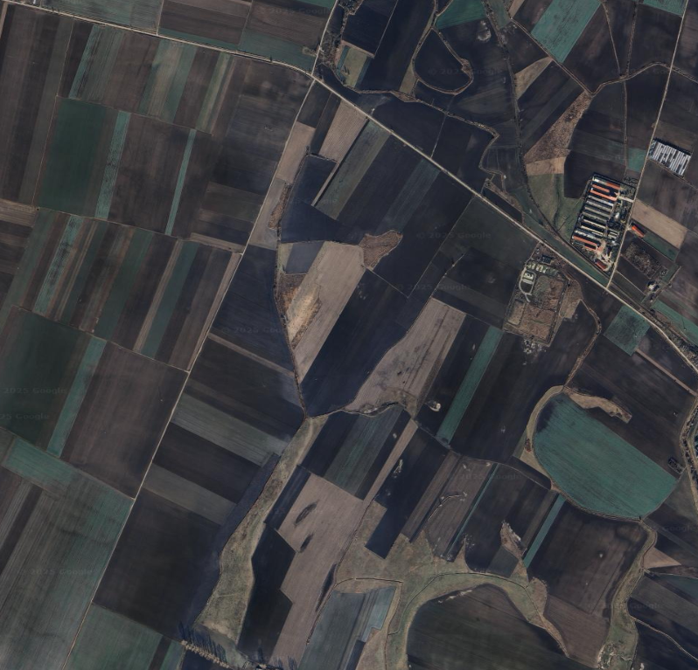
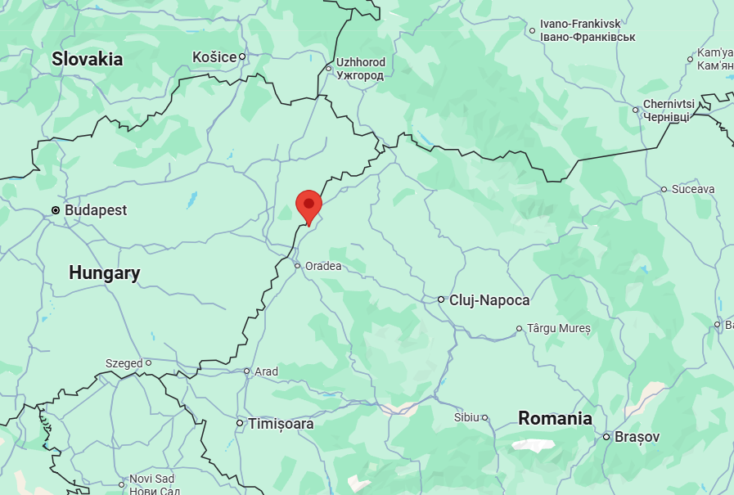
Site 2: Romania
ood-t MJJ2021 minicube_225_34TET_47.37_22.05

Slide 10
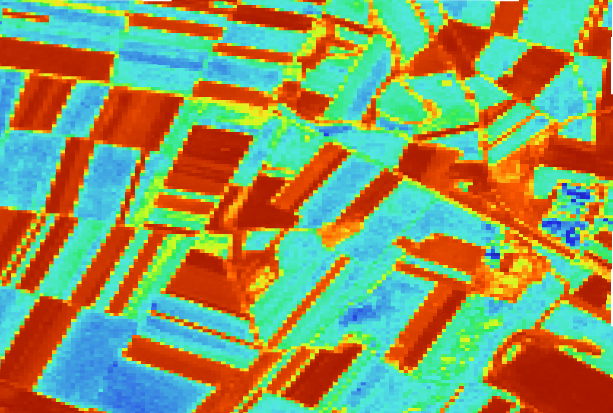
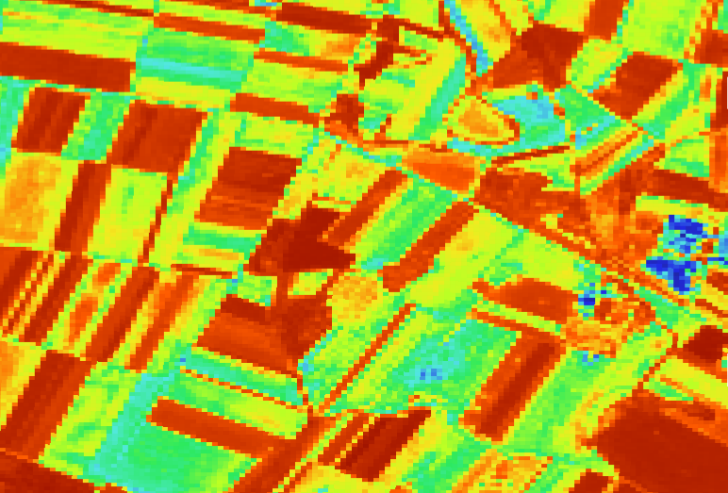
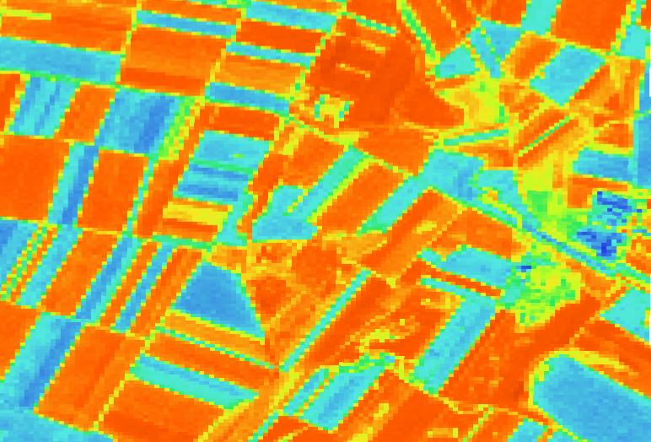
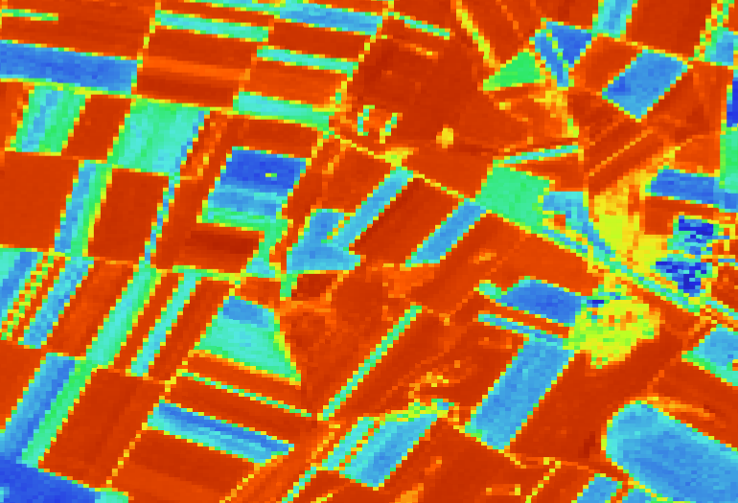
Actual NDVI
Timestep 5
May 21
Timestep 10
June 15
Timestep 16
July 15
Timestep 19
July 30

Slide 11
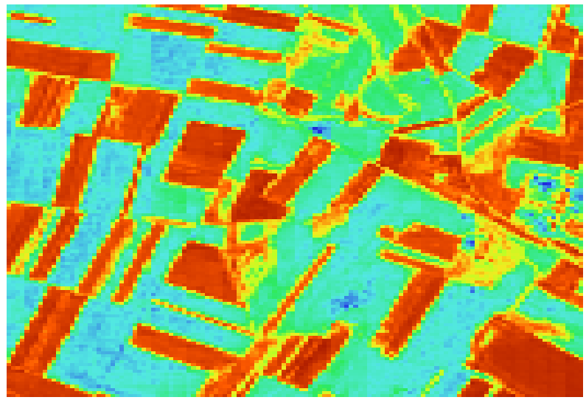
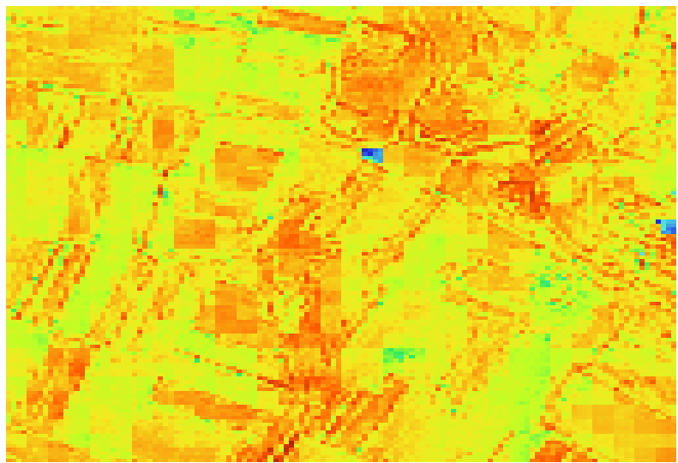
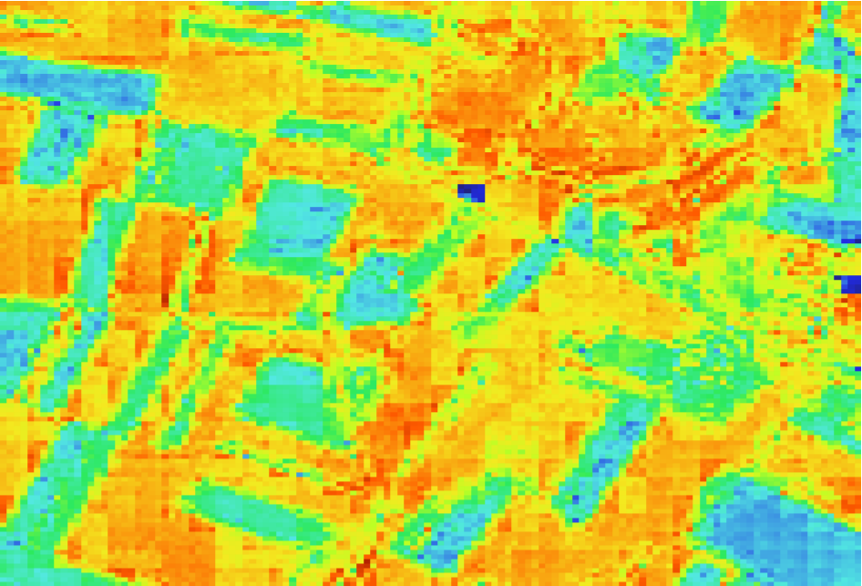
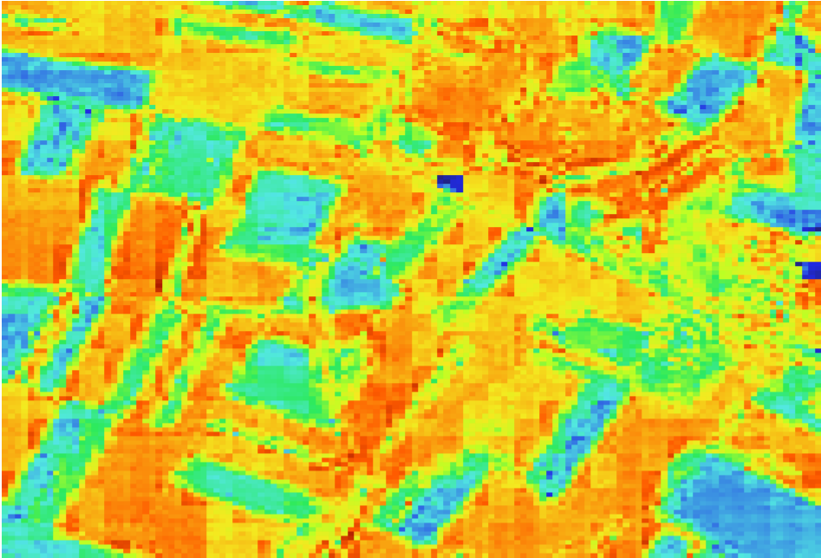
Predicted NDVI
Timestep 5
May 21
Timestep 10
June 15
Timestep 16
July 15
Timestep 19
July 30
Notes:
Why is spatial coherence lost in time step 10 but recovered at timestep 16? Did it hallucinate on timestep 10? Seems like it never recovers in the top right region

Slide 12
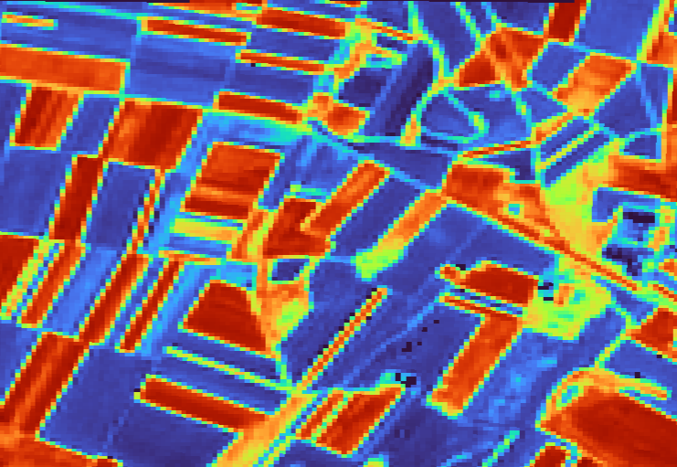
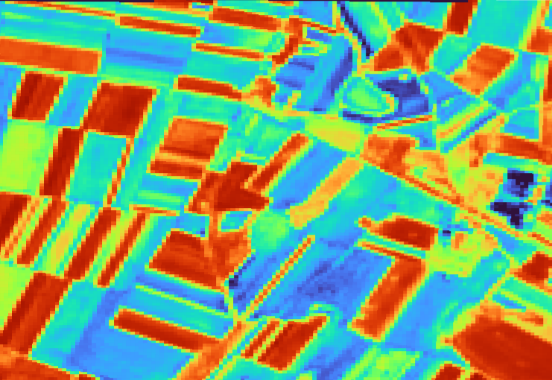
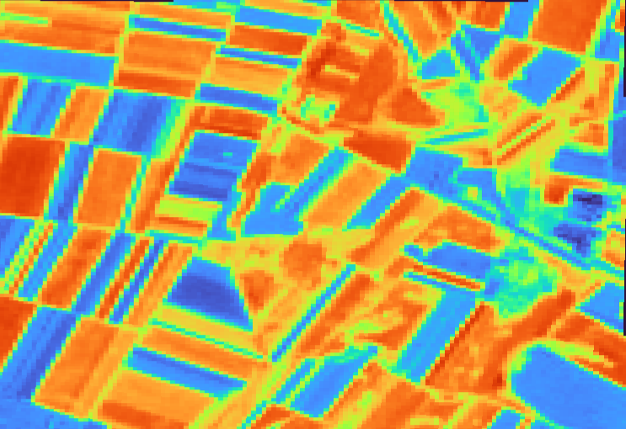
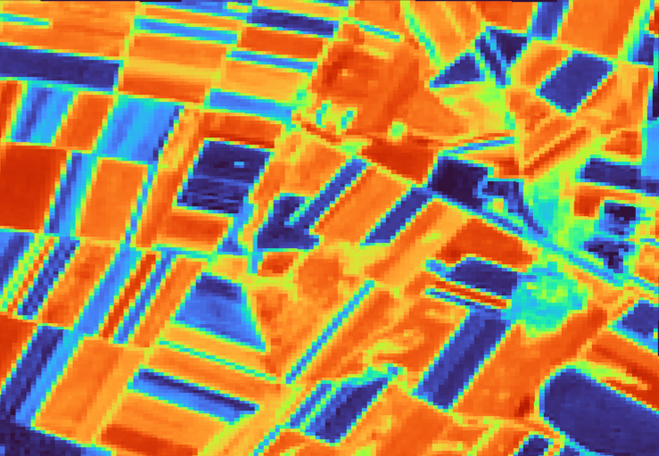
Actual fCover
Timestep 5
May 21
Timestep 10
June 15
Timestep 16
July 15
Timestep 19
July 30

Slide 13
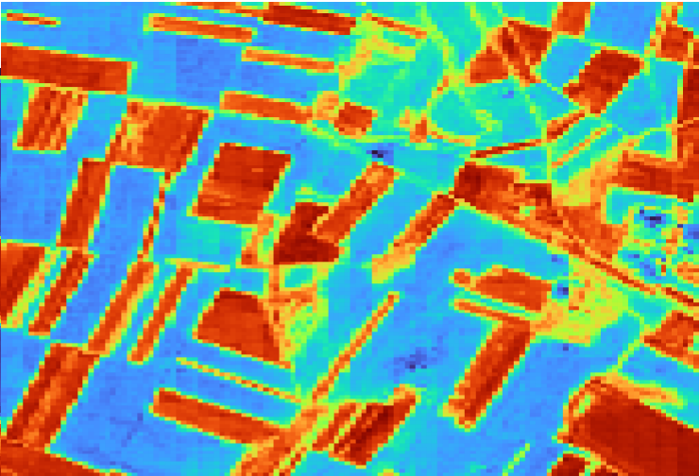
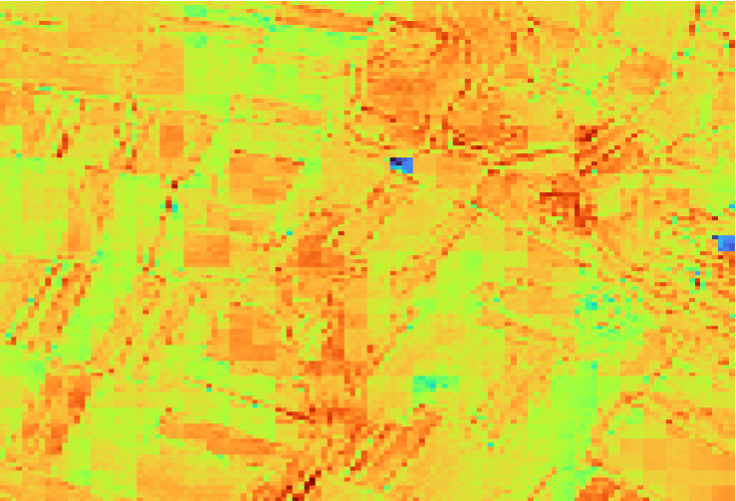
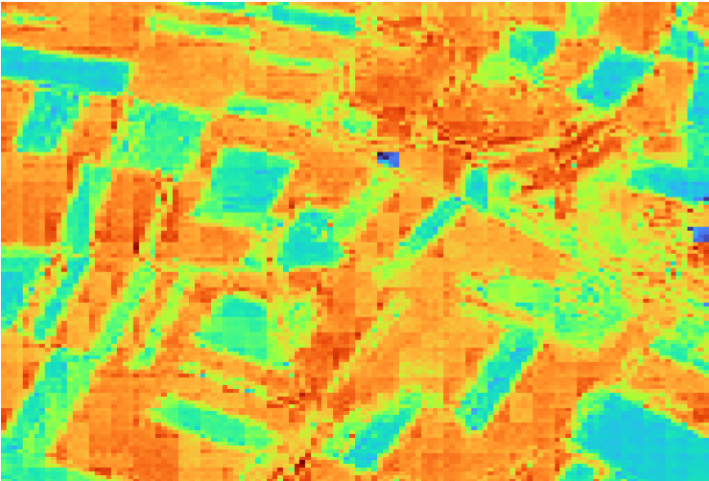
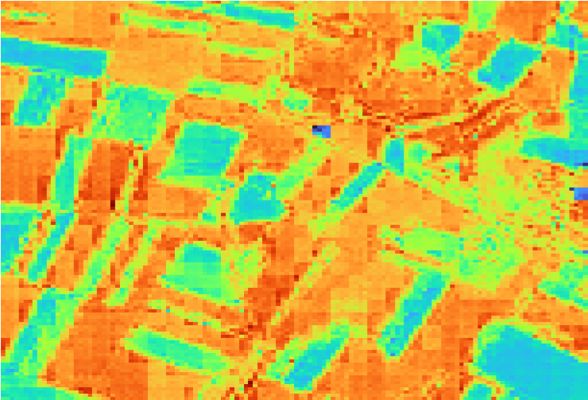
Converted fCover
Timestep 5
May 21
Timestep 10
June 15
Timestep 16
July 15
Timestep 19
July 30
Notes:
Why is spatial coherence lost in time step 10 but recovered at timestep 16? Did it hallucinate on timestep 10? Seems like it never recovers in the top right region

Slide 14
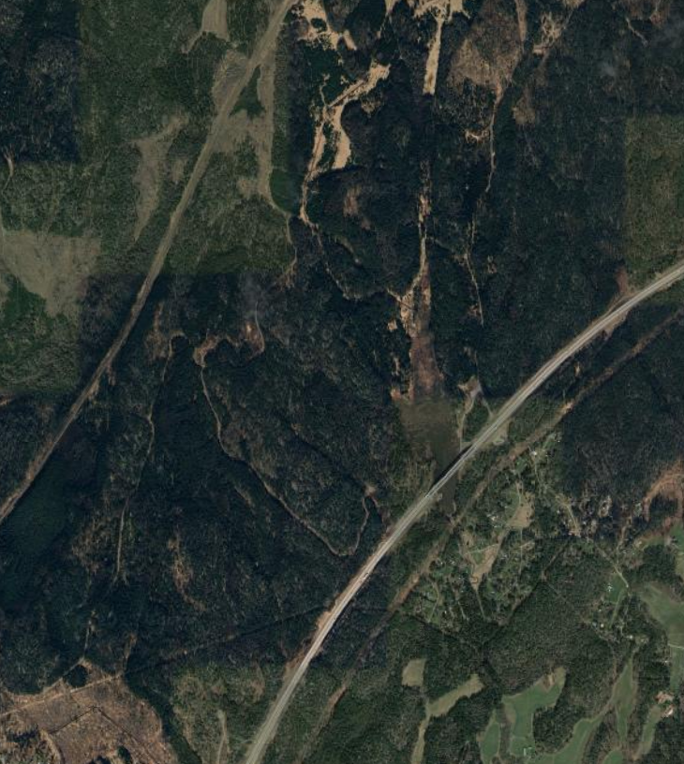
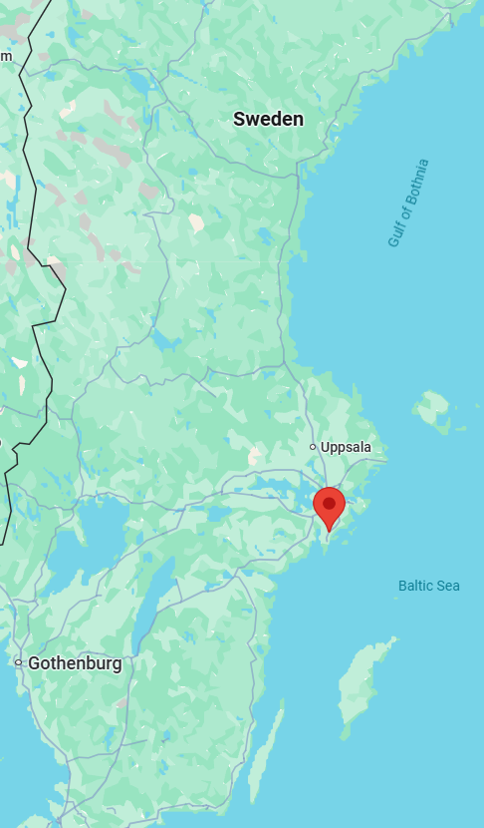
Site 3: Sweden
ood-t MJJ2021 minicube_241_34VCL_59.04_17.96

Slide 15
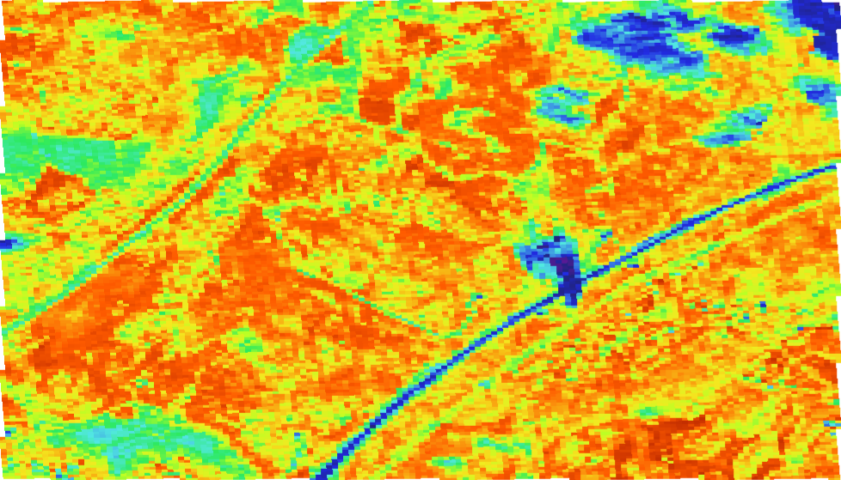
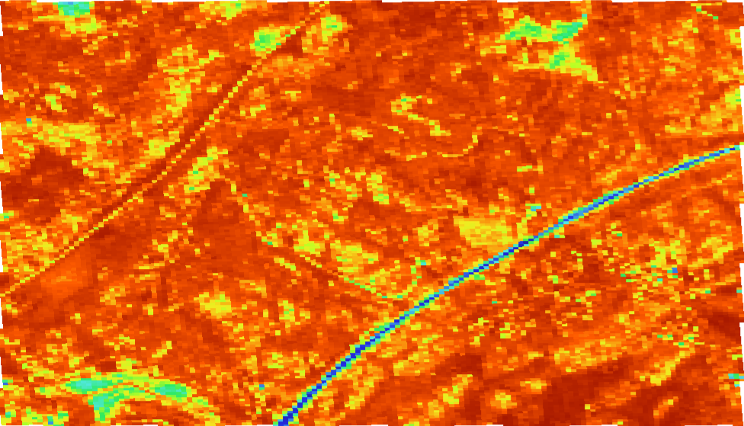
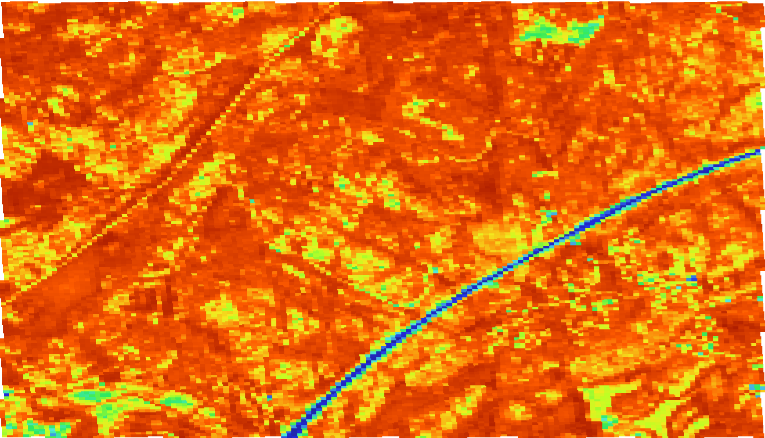
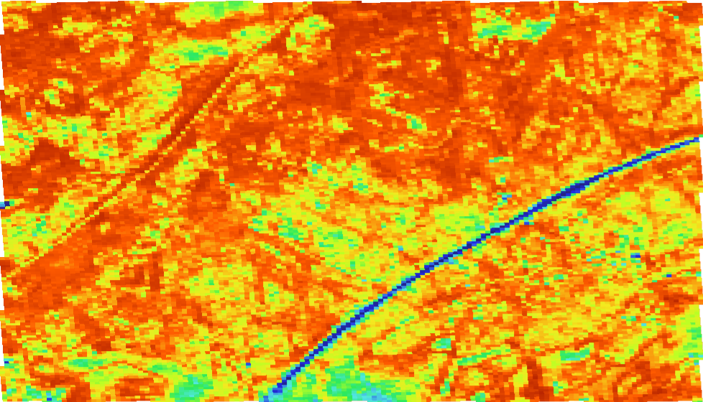
Actual NDVI
Timestep 4
May 18
Timestep 9.6
June 15
Timestep 15.6
July 15
Timestep 19.6
August 4
Note: There were cloud shadows in the bottom two thirds of the image

Slide 16
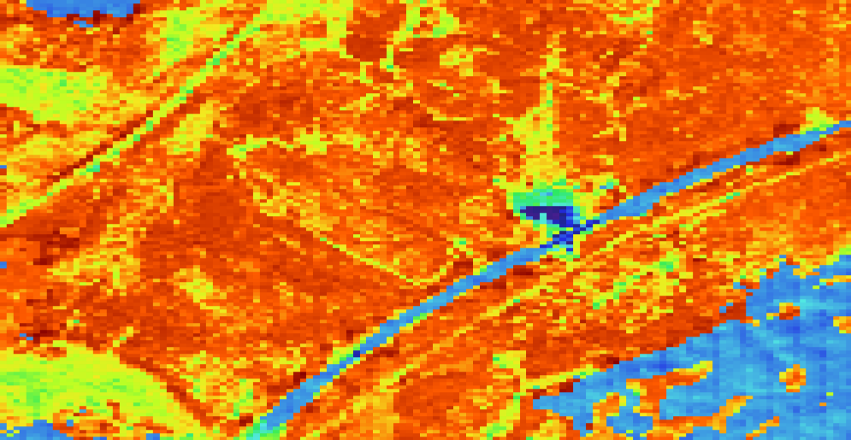
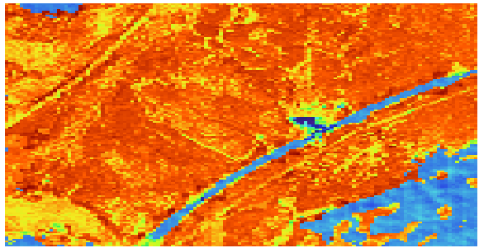
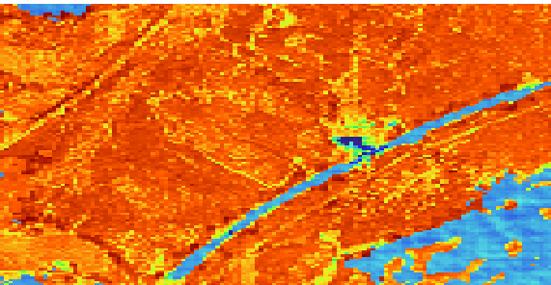

Predicted NDVI
Timestep 4
May 18
Timestep 10
June 17
Timestep 15 July 12
Timestep 20
August 6
Notes:
Timestep 4 is clearly wrong, largely in magnitude but also in pattern. Blocking is more noticeable in blue NDVI regions. The prediction looks better in contrast to cropland where NDVI changes even in dense patches.

Slide 17



Minicube NDVI
Timestep -8
March 19
Timestep -4
April 8
(Predicted)
May 18
Timestep -1 April 23
Notes:
Looking at the inputs as a possible explanation for the deviation between the predicted and actual NDVI at timestep 4.

Slide 18



Actual fCover
Timestep 4
May 18
Timestep 9.6
June 15
Timestep 15.6
July 15

Slide 19



Converted fCover
Timestep 4
May 18
Timestep 10
June 17
Timestep 15 July 12
Notes:
Timestep 4 is clearly wrong, largely in magnitude but also in pattern. Blocking is more noticeable in blue NDVI regions. The prediction looks better in contrast to cropland where NDVI changes even in dense patches.

Slide 20





NDVI time series
Predicted/Actual
Historical

Slide 21


The custom cloud mask can be seen to mask the highway and houses in the bottom right region
Clouds un-masked
Clouds masked
Notes:
We don’t mind it for this project, just making sure that Vitus is aware of the issue.

Slide 22


Training
Batch size | Runtime | Specifications
1 site single timeslice | ~8.5 hours for 100 epochs | 100% GPU ~5% CPU ~80GB RAM
10 sites 5222 timeslices in total | ~7 hours/epoch
85 sites 23816 timeslices in total | ~16.5 hours/epoch | No GPU ~50% CPU ~70-100GB RAM

